Slide 1

Things Are Hotting Up
A 2011 Update On Climate Change Science
Dr Alec Joubert
alec@kulima.com
Climate Change Thinkers Forum
10 February 2011

Slide 2
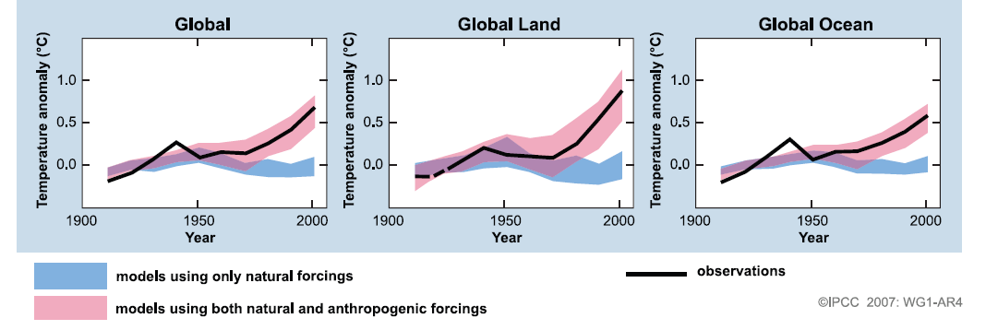
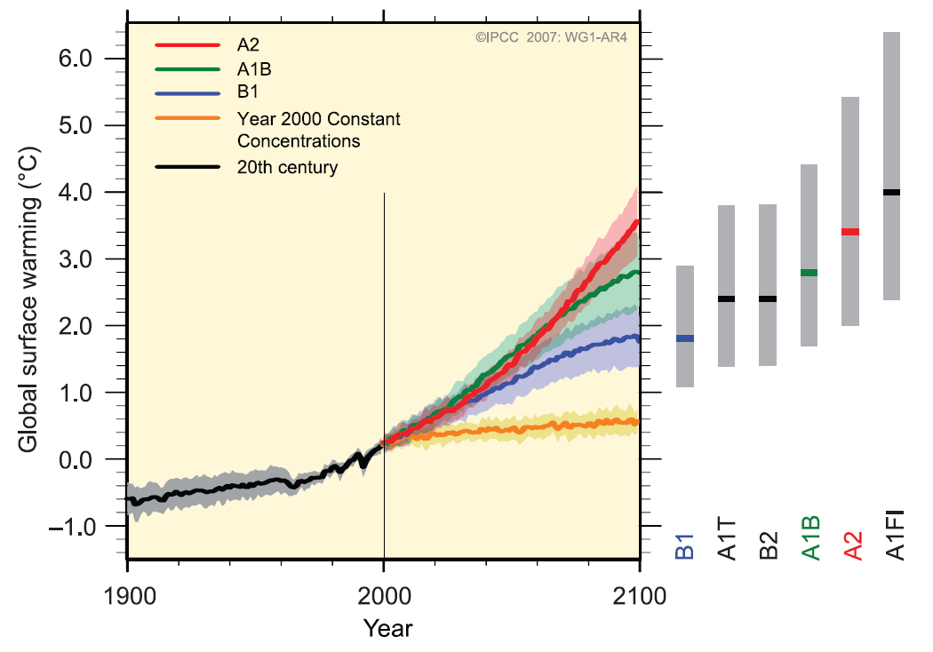
IPCC 2007 AR4

Slide 3
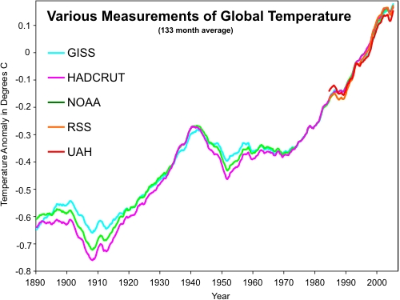
Observed Temperature Trends
Source: Skeptical Science: www.skepticalscience.com

Slide 4
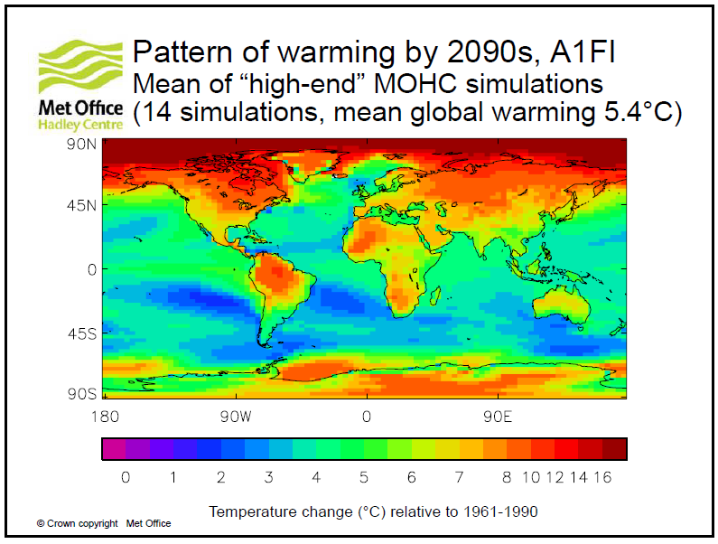
4°C and Beyond
Source: Betts et al, 2009

Slide 5
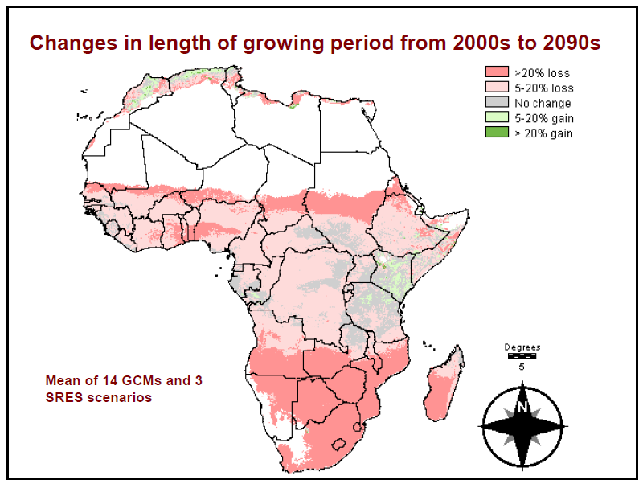
Regional Impacts: Agriculture
Source: Thornton and Jones, 2009

Slide 6
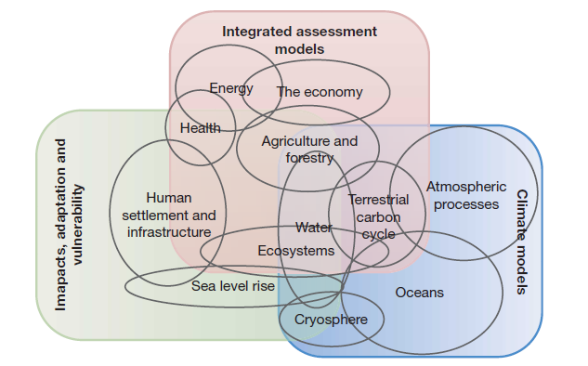
The 5th IPCC Assessment Report
Source: Moss et al 2010

Slide 7
Dr Alec Joubert
alec@kulima.com
Telephone: 033 343 3066
Mobile: 073 170 4904
Postnet Suite H79
Private Bag x9118
Pietermaritzburg
3200

